Slide 1

CSP251 – Project Based Learning Lab
Sentiment Analysis Using AI
Presented by:
Muheed Muzamil
Sheikh Parvez Ahmad
Siddharth Gautam

Slide 2
INTRODUCTION

Slide 3
What is Sentiment Analysis :
Sentiment Analysis is the process of determining whether a piece of writing is positive, negative or neutral.
A sentiment analysis system for text analysis combines natural language processing (NLP) and Machine Learning techniques to assign weighted sentiment scores to the entities, topics, themes and categories within a sentence or phrase.
Sentiment analysis is extremely useful in social media monitoring as it allows us to gain an overview of the wider public opinion behind certain topics.
The ability to extract insights from social data is a practice that is being widely adopted by organizations across the world.

Slide 4
Block Diagrams And Algorithms

Slide 5
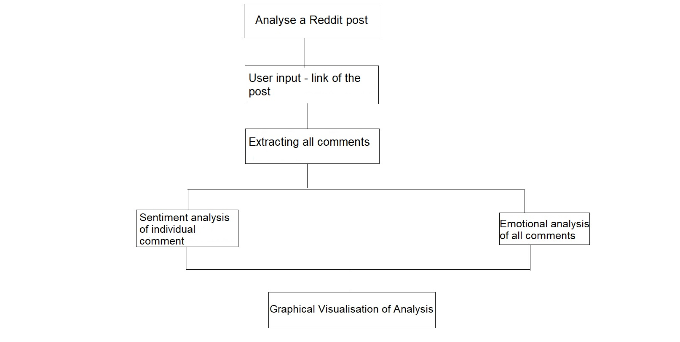
Block Diagram: For Analysis of Reddit Data

Slide 6
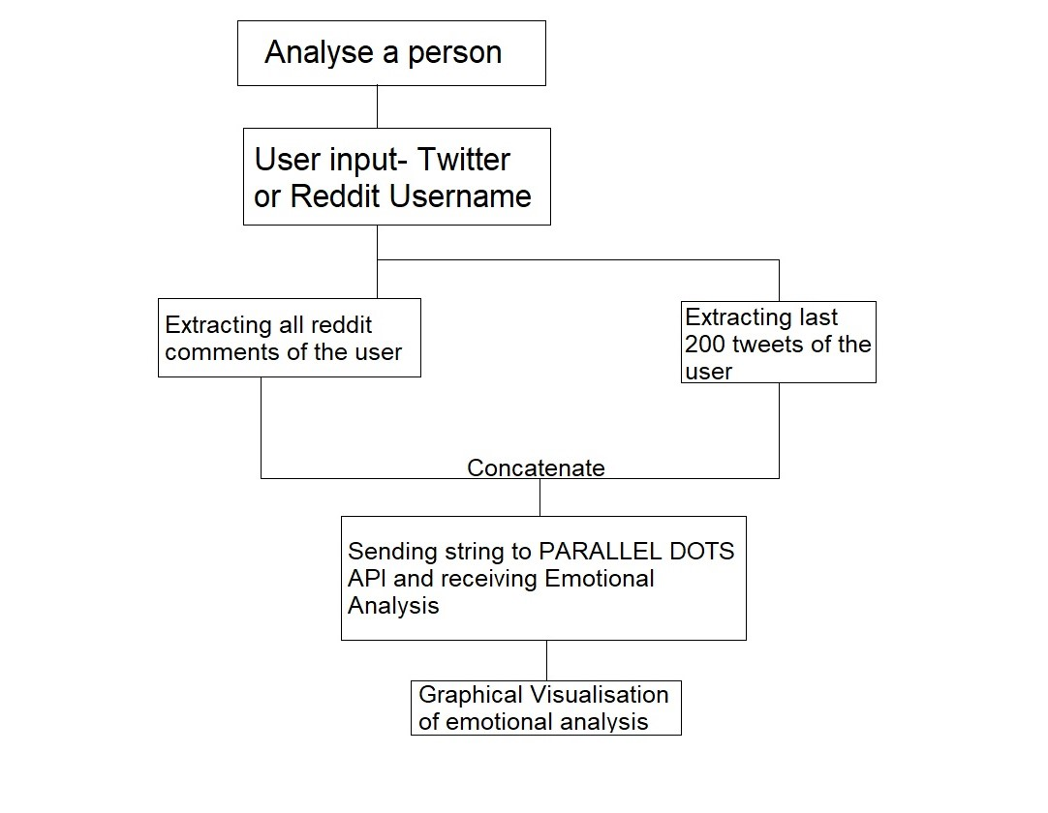
Block Diagram: For Analysis of a particular user

Slide 7
Block Diagram: For Analysis of an Audio file(mp3)
Analyse an audio file
User Input - Path of Audio File(mp3)
Transcribing speech to text
Emotional analysis on the text of speech
Graphical representation of Emotional Analysis

Slide 8
System Requirements

Slide 9
Recommended System Requirements
Processors:
Intel® Core™ i5 processor 4300M at 2.60 GHz or 2.59 GHz (1 socket, 2 cores, 2 threads per core), 8 GB of DRAM
Intel® Xeon® processor E5-2698 v3 at 2.30 GHz (2 sockets, 16 cores each, 1 thread per core), 64 GB of DRAM
Intel® Xeon Phi™ processor 7210 at 1.30 GHz (1 socket, 64 cores, 4 threads per core), 32 GB of DRAM, 16 GB of MCDRAM (flat mode enabled)
Disk space: 2 to 3 GB
Operating systems: Windows® 10, macOS®, and Linux®
Minimum System Requirements
Processors: Intel Atom® processor or Intel® Core™ i3 processor
Disk space: 1.5 GB
Operating systems: Windows® 7 or later, macOS®, and Linux®
Python versions: 2.7.X, 3.6.X
Included development tools: Conda, Conda-Env, Jupyter Notebook (IPython)
Compatible tools: Microsoft Visual Studio®, PyCharm
Included Python packages: NumPy, SciPy, scikit-learn, pandas, Matplotlib, Numba, Intel® Threading Building Blocks, pyDAAL, Jupyter, mpi4py, PIP, and others.

Slide 10
Some Python IDE :
PyCharm: PyCharm is one of the widely used Python IDE which was created by Jet Brains. It is one of the best IDE for Python. PyCharm is all a developer’s need for productive Python development.
With PyCharm, the developers can write a neat and maintainable code. It helps to be more productive and gives smart assistance to the developers. It takes care of the routine tasks by saving time and thereby increasing profit accordingly.
Platform Support: WINDOWS, LINUX, MAC etc.
-------------------------------------------------------------------------------------------------------------------------------------------------
SPYDER: SPYDER is another big name in the IDE market. It is a good python compiler.
It is famous for python development. It was mainly developed for scientists and engineers to provide a powerful scientific environment for Python. It offers an advanced level of edit, debug, and data exploration feature. It is very extensible and has a good plugin system and API. As SPYDER uses PYQT, a developer can also use it as an extension. It is a powerful IDE.
Platform Support: QT, WINDOWS, LINUX, MAC OS etc.
------------------------------------------------------------------------------------------------------------------------------------------------------------------
IDLE: IDLE is a popular Integrated Development Environment written in Python and it has been integrated with the default language. It is one of the best IDE for python.
IDLE is a very simple and basic IDE which is mainly used by the beginner level developers who want to practice on python development. It is also a cross-platform thus helping the trainee developers a lot but it also called as a disposable IDE as a developer moves to more advance IDE after learning the basics.
Platform Support: WINDOWS, LINUX, MAC OS etc.
-------------------------------------------------------------------------------------------------------------------------

